Slide 1
RISK IS OPPORTUNITY
Presented by: Mathematics Department The University of the West Indies (Mona) April 25, 2019

Slide 2
Climate Change Risks
Presented By: Howard Hines, FSA, MAAA
Director of Actuarial Science
University of the West Indies (Mona)

Slide 3
RISK IS OPPORTUNITY
Risk $≡$ Unexpected Variability

Slide 4
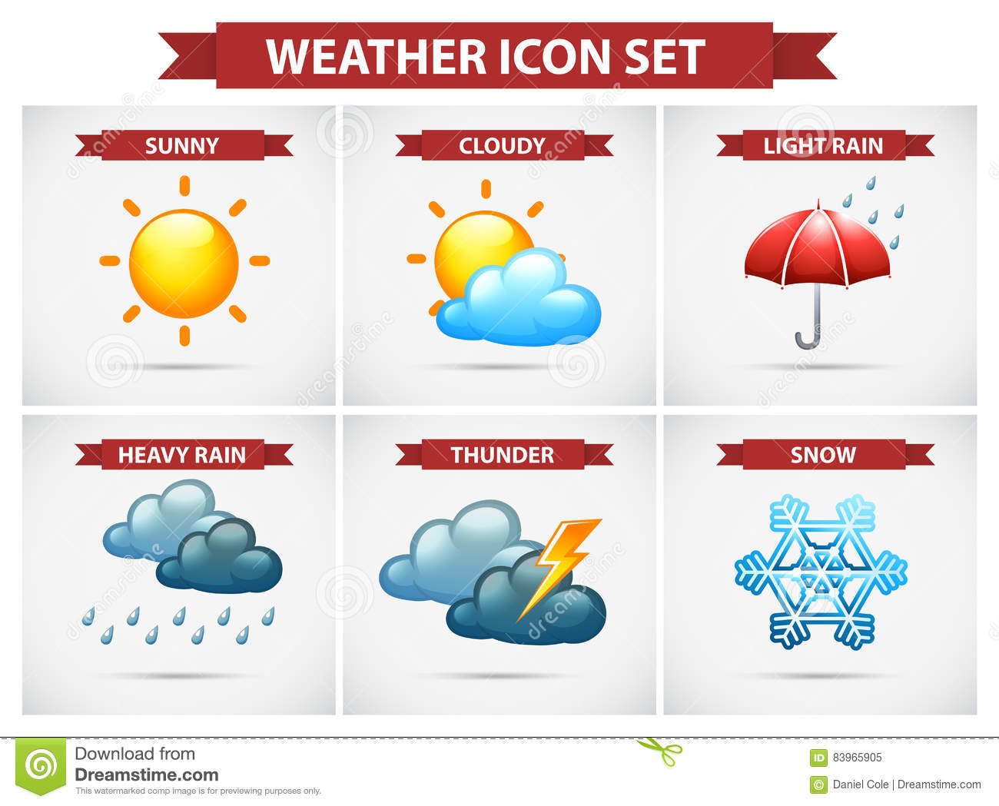
KEYWORDS
Climate
the weather conditions prevailing in an area in general or over a long period

Slide 5
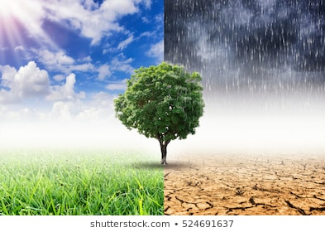
KEYWORDS cont’d
Climate
Climate Change (Hotter,
Wetter, Drier)
Temperature
Precipitation (rainfall)
Sea level rise

Slide 6
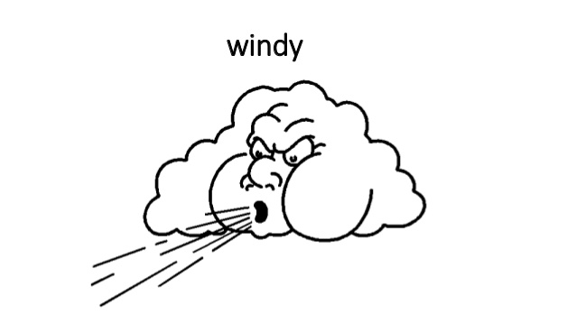
KEYWORDS cont’d
Climate
Climate Change (Hotter, Wetter, Drier)
Temperature
Precipitation (rainfall)
Sea level rise
Adaptation
Adjustment in natural or human systems in response to actual or expected climatic stimuli
Moderates harm or exploits beneficial opportunities
Adaptation may be reactive or anticipatory

Slide 7
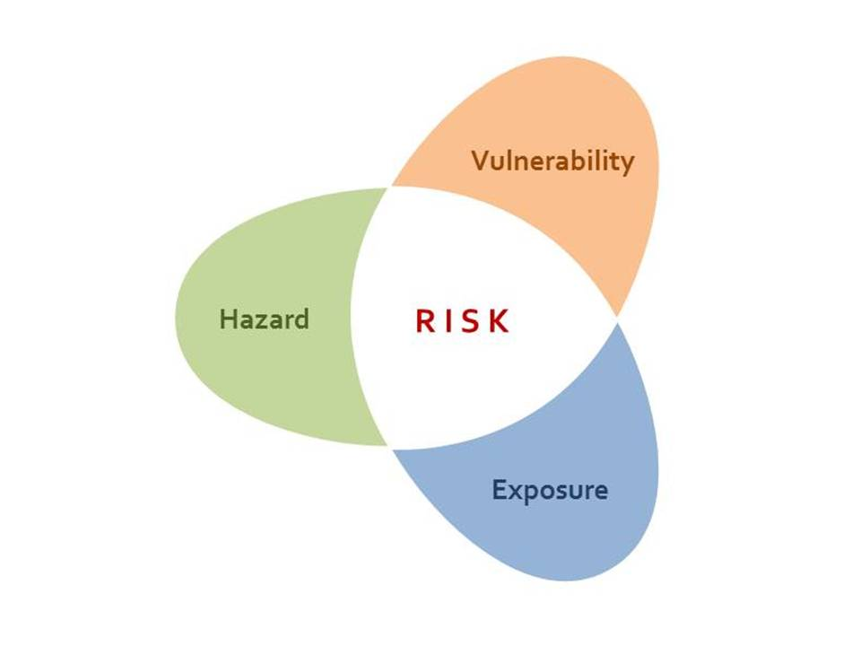
KEYWORDS cont’d
Climate
Climate Change (Hotter, Wetter, Drier)
Temperature
Precipitation (rainfall)
Sea level rise
Adaptation
Vulnerability
The extent to which climate change may damage or harm a system
Depends not only on the system’s sensitivity
Also depends on ability to adapt to new climactic conditions

Slide 8
OPPORTUNITIES
Refocus

Slide 9
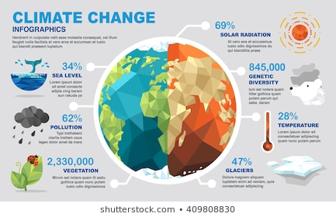
OPPORTUNITIES cont’d
Refocus
Rebuild

Slide 10
OPPORTUNITIES cont’d
Refocus
Rebuild
Renew

Slide 11
OPPORTUNITY 1
Refocus

Slide 12
OPPORTUNITY 1 cont’d
Refocus
Vulnerable groups e.g. elderly and very young

Slide 13
OPPORTUNITY 1 cont’d
Refocus
Vulnerable groups
Vulnerable species e.g. wildlife

Slide 14
OPPORTUNITY 1 cont’d
Refocus
Vulnerable groups
Vulnerable species
Vulnerable communities e.g. coastal communities due to sea level rise [10cm to 25 cm in the last century as noted by the Intergovernmental Panel on Climate Change (IPCC)]

Slide 15
OPPORTUNITY 1
Refocus
Vulnerable groups
Vulnerable species
Vulnerable communities
Vulnerable structures e.g. older buildings, drainage structures

Slide 16
OPPORTUNITY 2
Refocus
Rebuild

Slide 17
OPPORTUNITY 2 cont’d
Refocus
Rebuild
Replant (agriculture)
$Gross Marginal Profit=\sum_{i=1}^{N}{{price}_{i}{yield}_{i}−\sum_{j=1}^{M}{{input component}_{j}{cost}_{j}−Overhead}}$

Slide 18
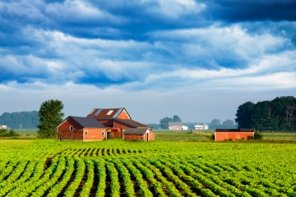
JOHN’S FARM
Plants Scotch Bonnet peppers
Uses the following inputs:
Irrigation
Fertilizer
Pesticides
Exposed to increased rainfall risk
Less exposed to reduced rainfall risk
Graduate of Faculty of Science and Technology (Mathematics)

Slide 19
JOHN’S RISK

Slide 20
RISK IS OPPORTUNITY
John forecasts his risk and quickly intervenes with:
Reduced irrigation
Increased fertilization
Increased pest control

Slide 21
JOHN’S OPPORTUNITY
Increased rainfall

Slide 22
The Four R’s
Refocus
Rebuild
Replant
Restructure
Finances e.g. diversify income streams
Debt e.g. longer repayment periods at lower interest rates
Access to aid e.g. improve negotiation

Slide 23
Risk is Opportunity
Refocus
Rebuild
Replant
Restructure
Restore
Improve building codes
Drainage
Infrastructure

Slide 24
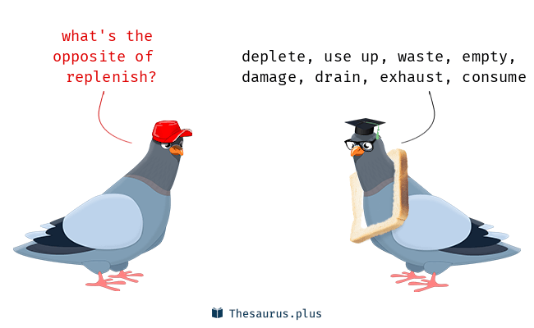
Risk is Opportunity
Refocus
Rebuild
Replant
Restructure
Restore
Replenish
Water resources
Reservoirs ( currently below 40% capacity)

Slide 25
OPPORTUNITY 3
Refocus
Rebuild
Renew

Slide 26
NEXT STEPS
Refocus
Rebuild
Renew
Renewed attitudes
Not just plastic ban
Retraining (e.g. competition for water resources needs to lead to less water usage)
Eating habits of flora and fauna may need to change
Reviewed zoning codes for
Habitation
Commercial activities e.g. mining

Slide 27
NEXT STEPS cont’d
Refocus
Rebuild
Renew
Renewed attitudes
Renewed allocations
A conscious effort must be made by Governments, Private Sector and households to develop resilience
Current insurance fund, Caribbean Catastrophe Risk Insurance Facility (CCRIF)
In 2007, the Caribbean Catastrophe Risk Insurance Facility was formed as the first multi-country risk pool in the world
CCRIF offers earthquake, tropical cyclone and excess rainfall policies to Caribbean and Central American governments.
CCRIF helps to mitigate the short-term cash flow problems small developing economies suffer after major natural disasters

Slide 28
NEXT STEPS cont’d
Refocus
Rebuild
Renew
Renewed attitudes
Renewed allocations
Renewed aspirations
Planning must contemplate climate change issues e.g. anticipatory adaptation and resilience building for all
2030 goals: MAKE JAMAICA, A PLACE OF CHOICE TO LIVE, WORK, RAISE FAMILIES, DO BUSINESS AND ENJOY THE CLIMATE

