Slide 1
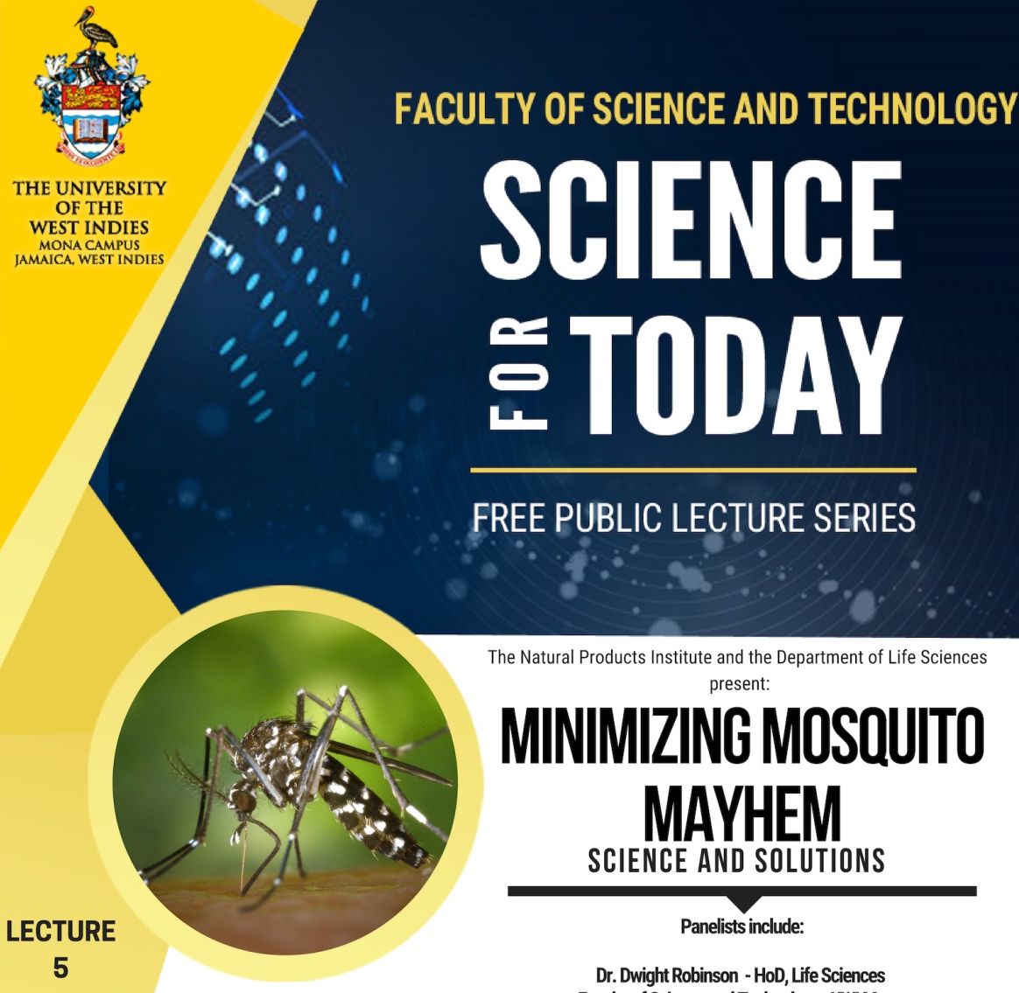

Slide 2
Mosquito Mayhem?
What do these mosquitoes want from us?
What role did we play in creating this mayhem?
Can we fix the problem?

Slide 3
Mosquitoes
Mosquitoes were around long before humans
There are over 3500 known species of mosquitoes
Only around 100 species are known to be vectors of diseases

Slide 4
Mosquitoes
Since mosquitoes were here before humans, they have evolved to specialize in biting humans
Humans have made a major contribution to the success of mosquitoes
Aedes mosquitoes have evolved habitat specialization involving adaptation to container habitats

Slide 5
Mosquitoes
Order: Diptera Family: Culicidae
The most common, and most dangerous species belong to the genera:
Culex
Anopheles
Aedes

Slide 6
Negative effects of Mosquitoes
West Nile virus
Malaria
Yellow fever, Dengue, Chikungunya, Zika
Culex
Anopheles
Aedes

Slide 7
Positive effects of Mosquitoes
Ecological services
Vital role in the food chain
Pollination

Slide 8
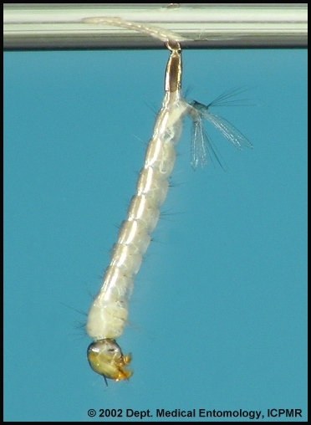
Mosquito larvae
Culex
Anopheles
Aedes

Slide 9
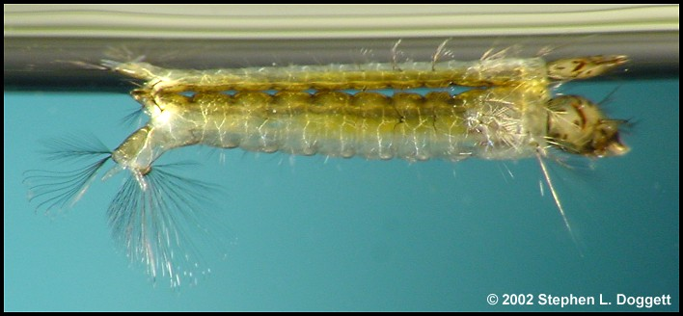
Mosquito larvae
Culex
Anopheles
Aedes

Slide 10
Mosquito larvae
Culex
Anopheles
Aedes

Slide 11
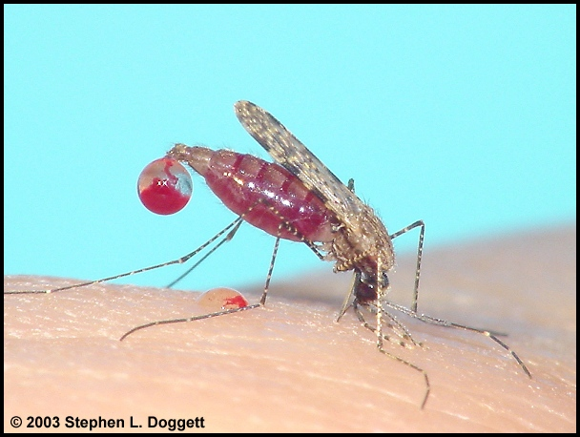
Why Mosquitoes Bite Humans?
Females need a blood meal to get the proteins necessary for egg development
They feed on nectar

Slide 12
How do they find us?
Chemically - Carbon dioxide, lactic acid and certain chemicals in sweat
Range 36 meters
Visually – Usually motion
Heat detection

Slide 13
What have we done to deal with the mayhem?
Our actions have primarily been two-pronged
Chemical control
Source reduction

Slide 14
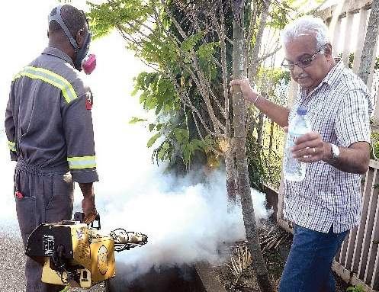

Slide 15
What have we done to deal with the mayhem?
Our actions have primarily been two-pronged
Chemical control
Source reduction

Slide 16
Solving the mayhem?
A knowledge-based approach
A focus on management, rather than control and certainly not eradication
Management requires a full knowledge of the biology and ecology of the mosquitoes

Slide 17
Knowledge required towards a solution
Ecology of mosquitoes
Distribution and abundance of different species
Focus on container mosquitoes
Intra and inter-specific competition
Biological control agents
DNA metabarcoding

Slide 18
Knowledge required towards a solution
Climatic factors
Mosquitoes are poikilothermic
Their ecology, development, behaviour and survival are impacted by climatic factors
Transmission dynamics of the diseases transmitted are strongly influenced by climatic factors
Mosquito climate modelling

Slide 19
Knowledge required towards a solution
Population dynamics of economically important species
Impact of seasonality, weather, predation
Use of mathematical and simulation modelling
Invasion biology of Aedes albopictus (The Asian Tiger Mosquito)

Slide 20
Towards a sustainable solution
An IPM approach
An integrated area-wide approach
A cost-effective surveillance program to facilitate the decision-making process
Ecological management (Requires input from human behavioural scientists)
Strategies that are more target specific with limited collateral damage (Environmentally friendly)

