Slide 1
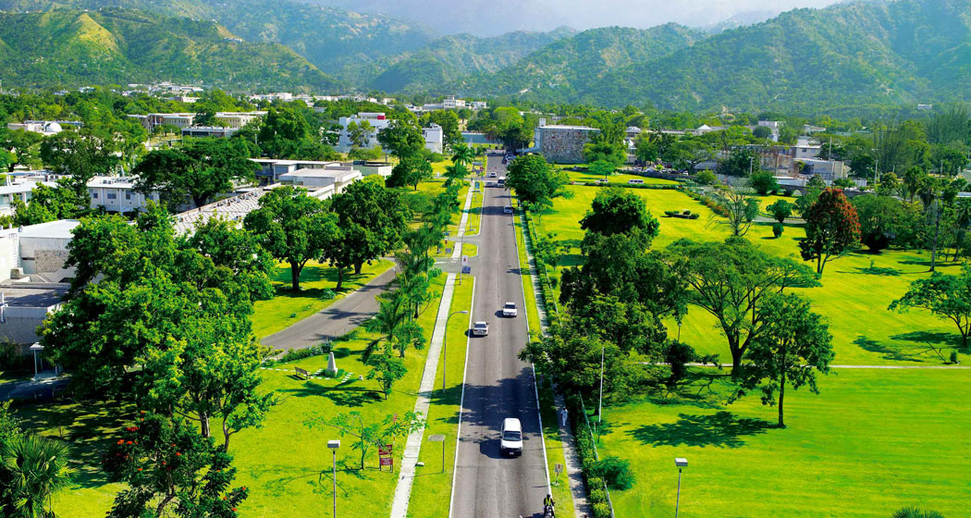
Mona Operational Plan
Employee Engagement & Development
My Mona. My Plan. Let’s Live It!

Slide 2
Message from the Principal
As the Campus seeks to operationalise its Plan, we recognise the importance of keeping members of staff informed on the progress of various initiatives.
This bulletin will provide information on the perspective: Employee Engagement & Development.
The Perspective owner is the Campus Registrar, Dr. Camille Bell-Hutchinson
Employee Engagement & Development

Slide 5
Employee Engagement & Development
The main objective of this Perspective is:
“To Improve the attraction and Retention of High Quality Staff”.
This Objective will be addressed through the implementation of three Campus Initiatives:
1. The Development and Implementation of a Programme for Leadership Transformation
2. A review and overhaul of the Performance Management System
3. The Development and Implementation of a Total Rewards Strategy and Programme

Slide 6
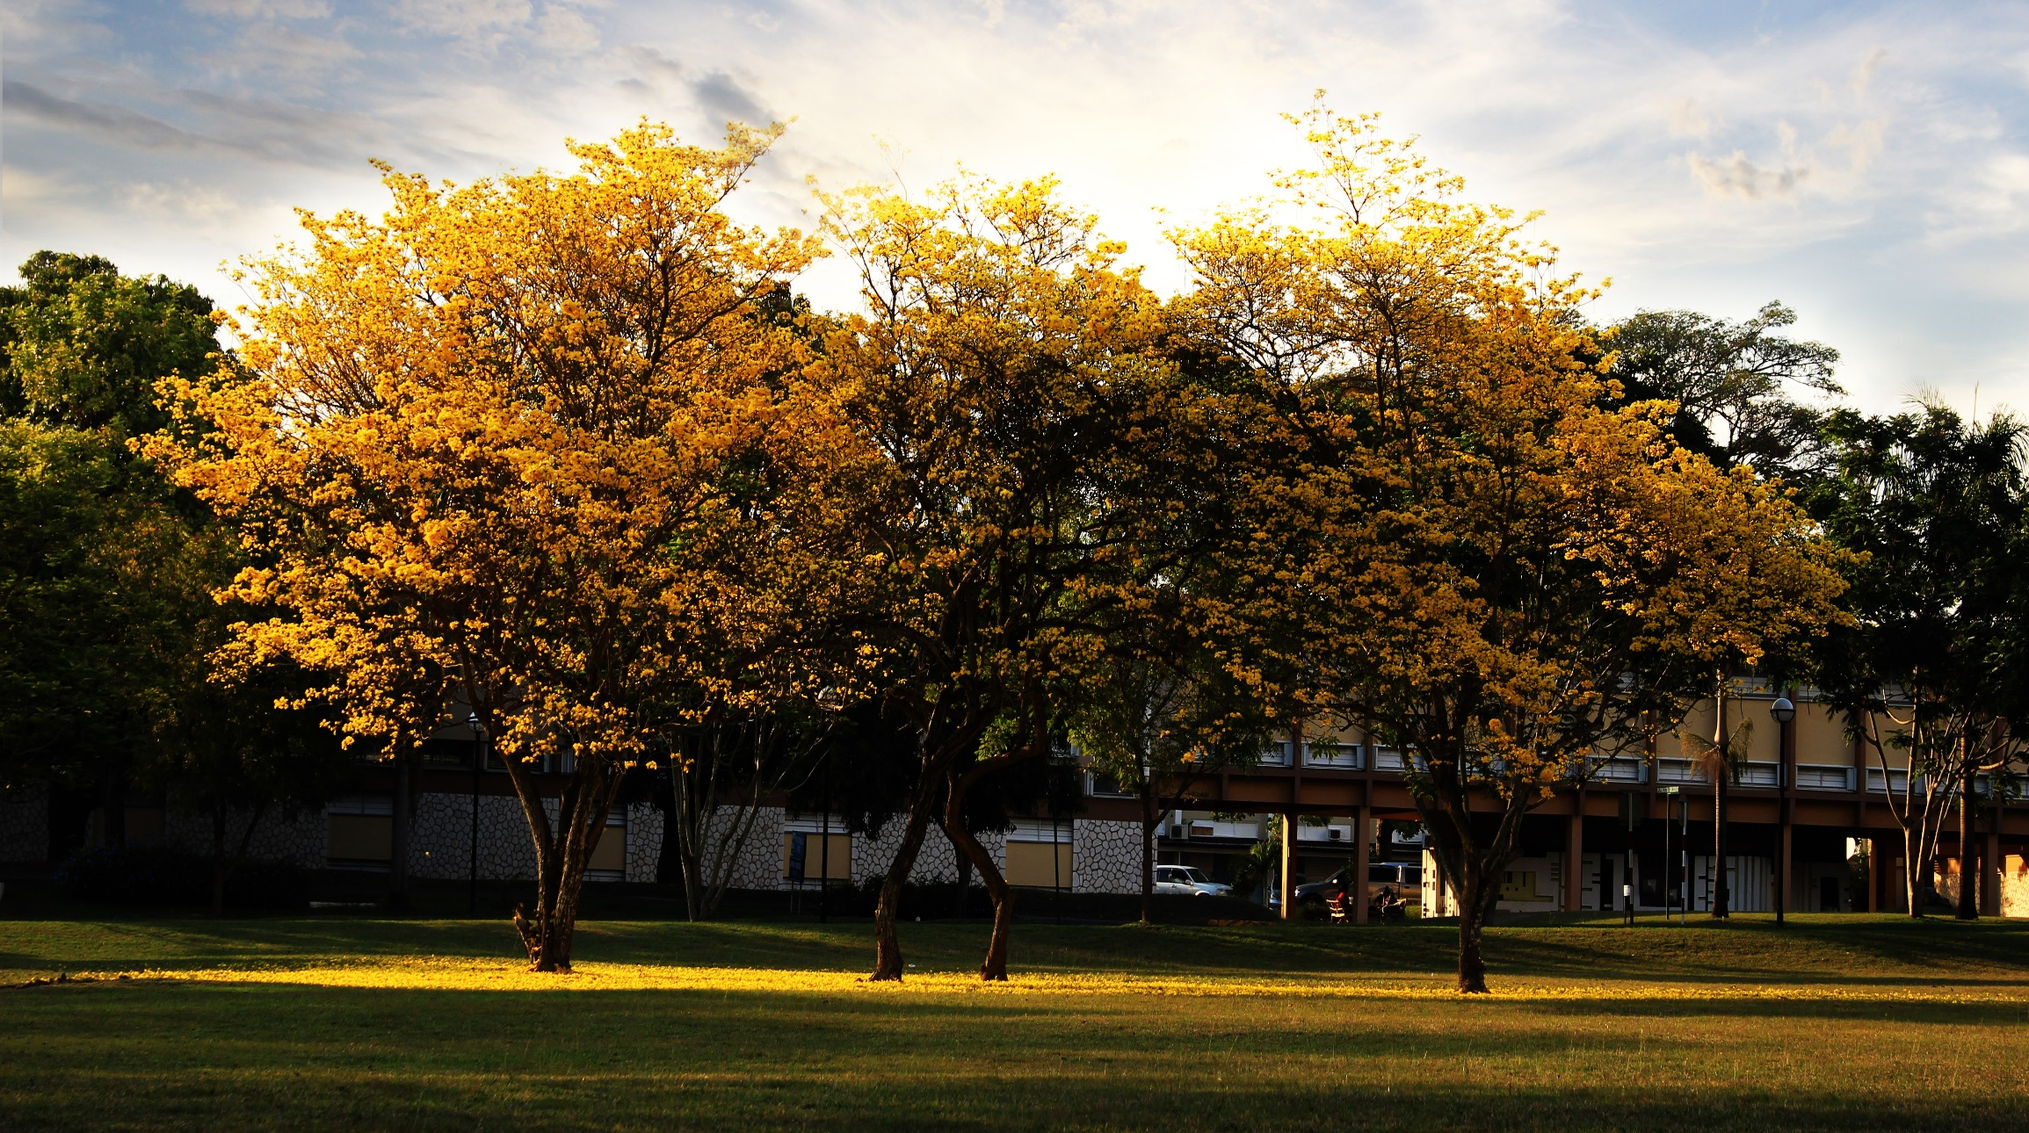
Initiative # 1. Programme for Leadership Transformation
The results of the last employee engagement survey raised serious concerns about staff perception of the quality of leadership provided by the leaders on the Mona Campus.

Slide 7
Programme for Leadership Transformation
The results indicated significant levels of disengagement with respect to:
The belief that the senior management team is concerned about their welfare
The sense of ownership that is required from staff in order for the UWI to be a great educational institution
Loyalty and spirit
Our customer focus
Understanding the University’s vision for transformation
The flow of information between departments that are connected

Slide 8
Project Goals and Objectives
Goal:
To develop managers who will improve attraction and retention rates by committing themselves to creating an environment where the best, the brightest and the most creative are attracted, motivated and set free to produce.
Main objectives:
a. To develop and implement a competency-based soft-skills programme for HODs, managers and supervisors across the campus.
b. To expose managers and supervisors to successful business men and women through a series of seminars.

Slide 9
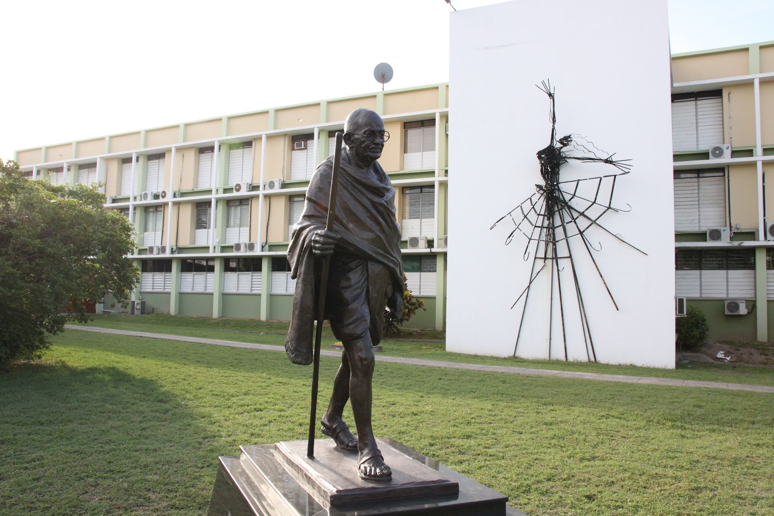
Initiative # 2. Review of the Performance Management System
The aim of this initiative is to enable a performance management framework which is more focused on employee development and recognition

Slide 11
Performance Management System
This project will include review of the following:
Workforce Strategy
Job Analysis and Assessments
Selection Systems
Performance Management System
Employee Development Systems
Talent Succession and Management

Slide 12
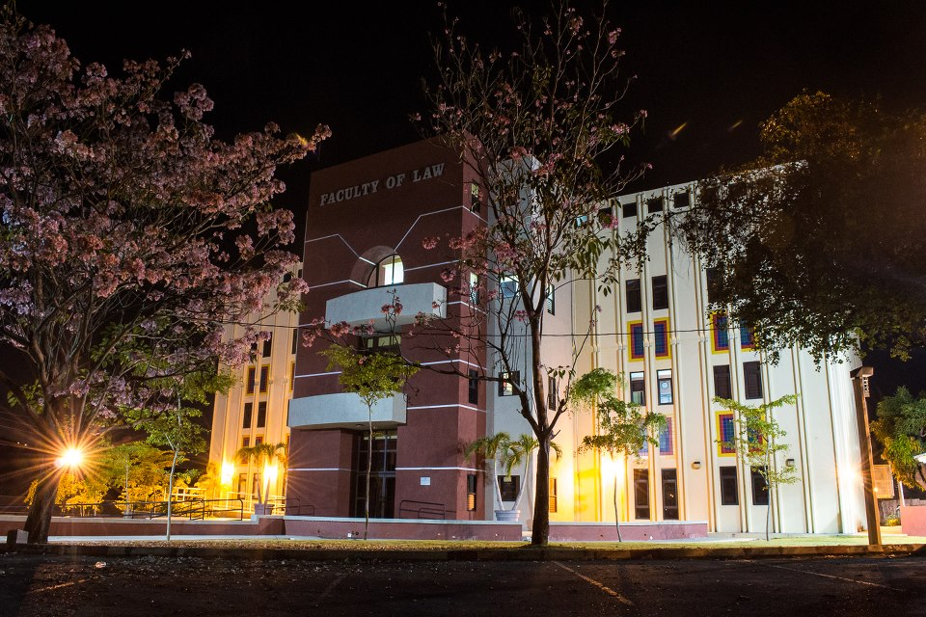
Initiative #3 Development of a Total Rewards Strategy
A total rewards strategy articulates an institution’s overall plan for the rewards it will offer in exchange for the excellent work and commitment of its Faculty and staff

Slide 13
Total Rewards Strategy
This will involve review of the following in a bid to improve employee satisfaction:
Compensation
Benefits
Work-Life balance
Performance & Recognition
Development and career opportunities

Slide 14
We need you!
The three initiatives will include a range of initiatives and may require the input of staff in the form of employee surveys and focus group discussions.
We look forward to your support as we seek to make The UWI, Mona a truly world-class institution.
My Mona. My Plan. Let’s Live it!

